Slide 1


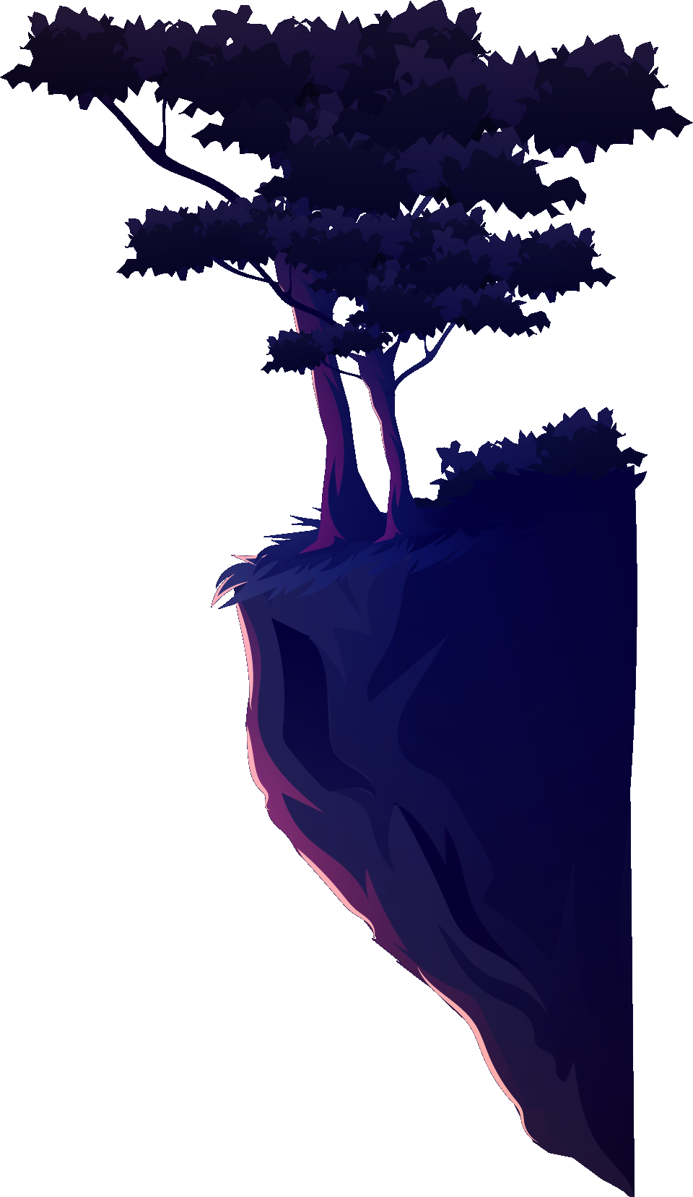
Wizard Showdown
Introduction to Computer Graphics
Gonçalo Cunha - 108352

Slide 2
Table of contents
01
04
01
05
03
06
07
Introduction
Animations/Shaders
Technologies
Illumination
Models
Demo
Future Work

Slide 3
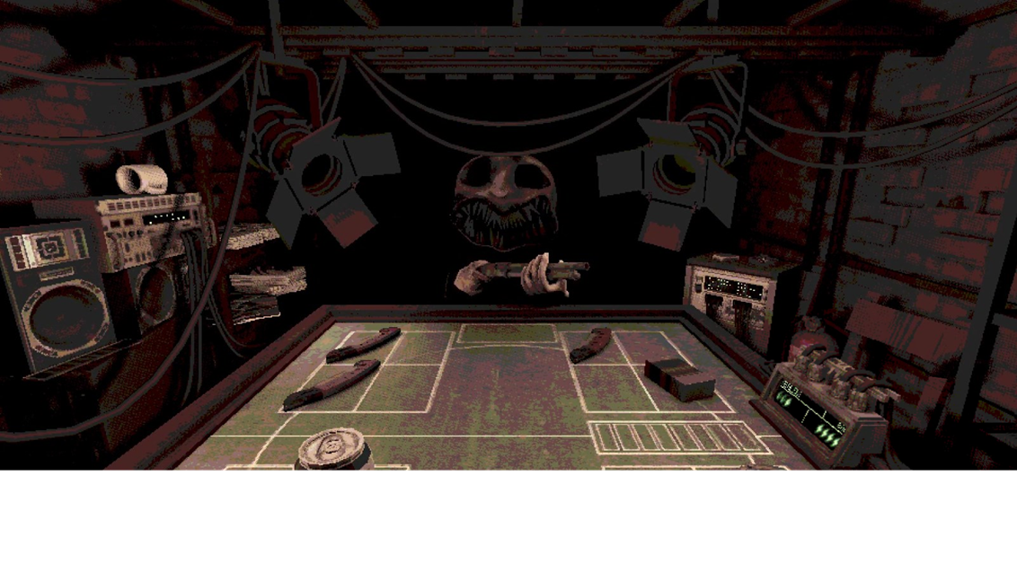

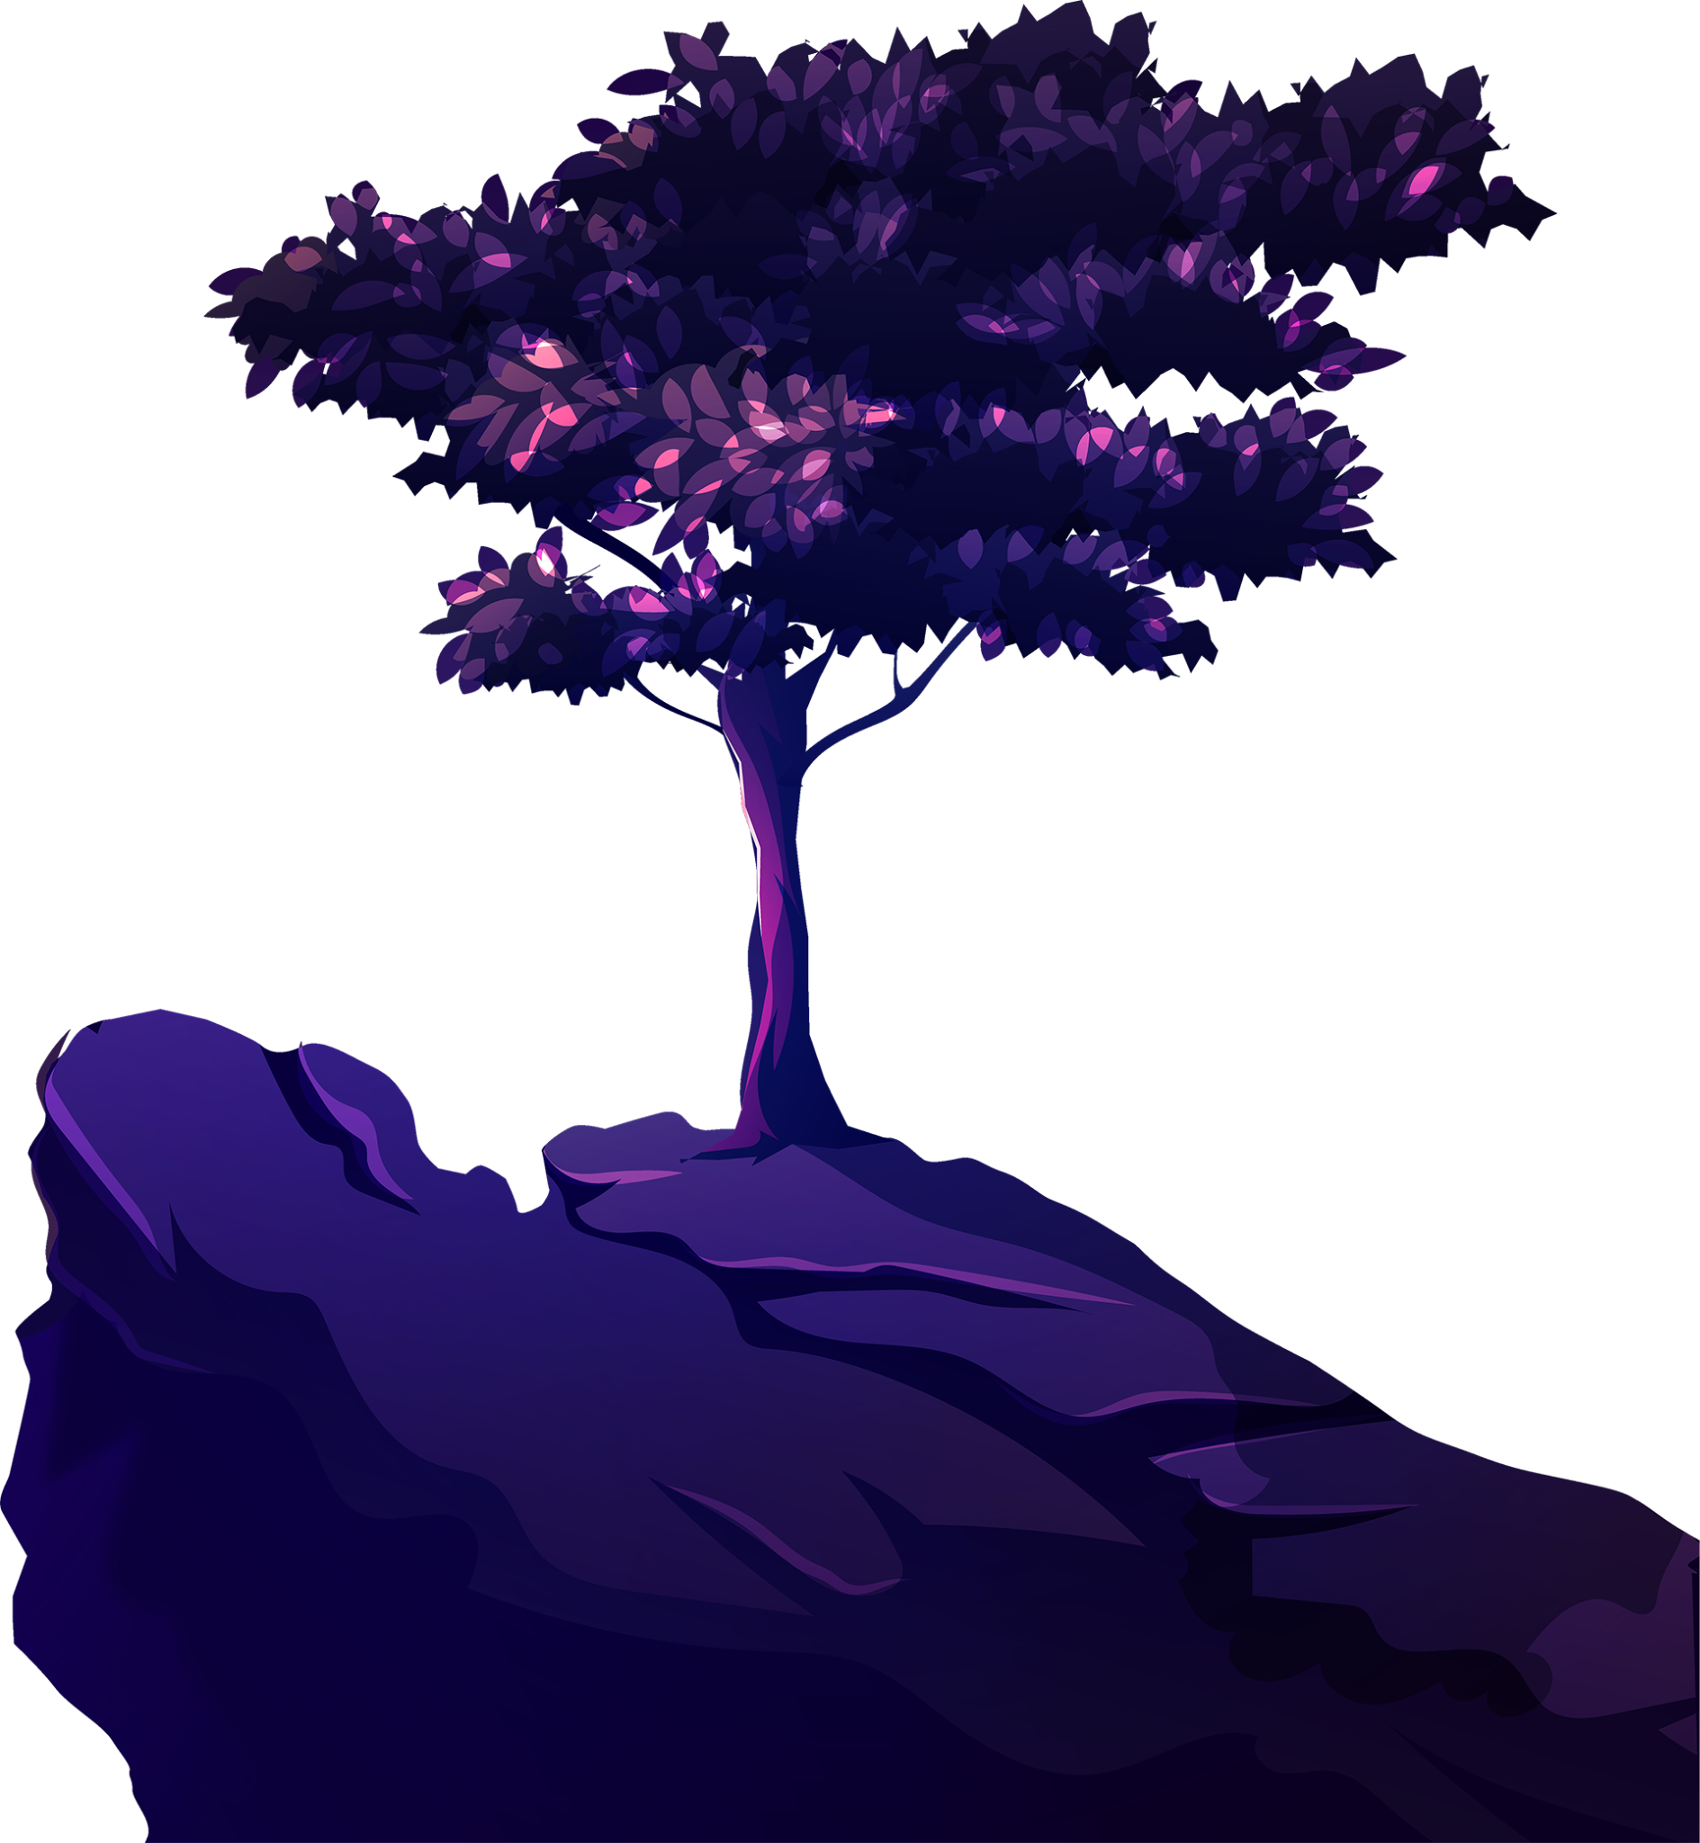
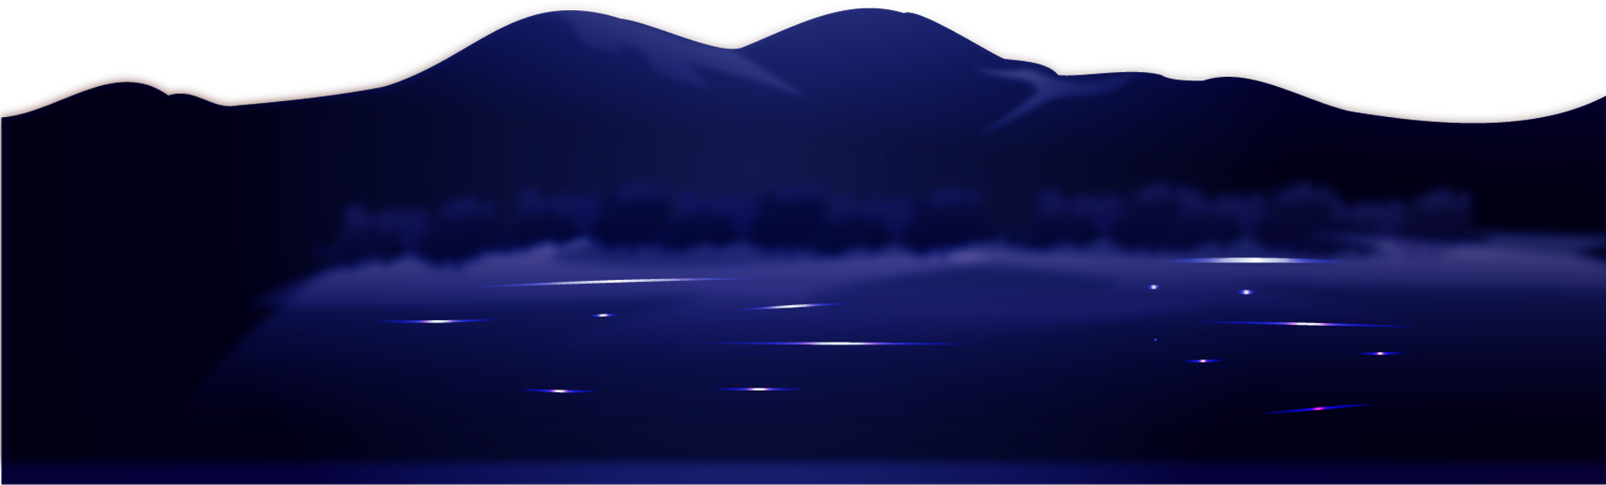
01 - Introduction
Project inspired by:
Buckshot Roulette
Rock, Paper, Scissors

Slide 4
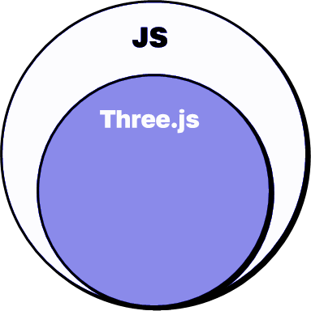

02 - Technologies

Slide 5
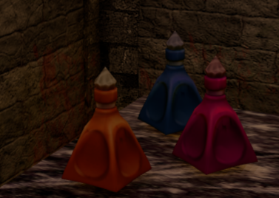
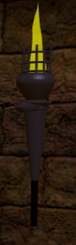
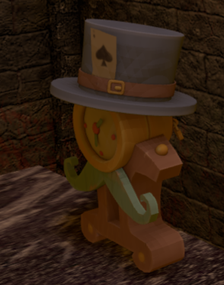
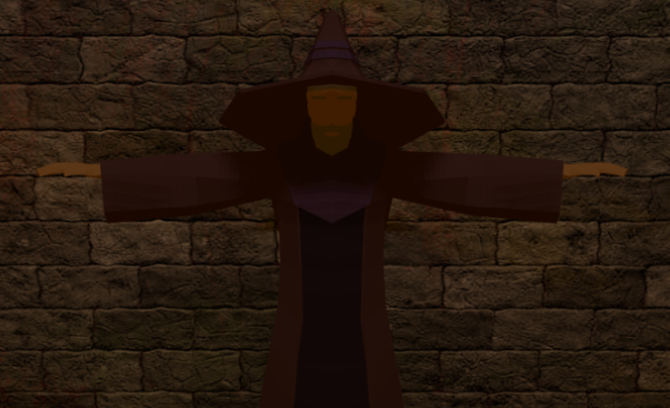
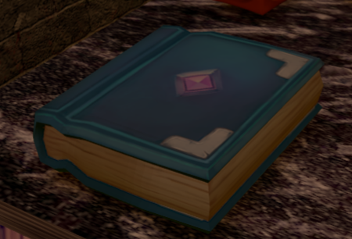
03 - Models

Slide 6
04 - Animation/Shaders
Custom Shaders
Added to spells to make them glow
Interactive Camera
First-person view controlled by holding the mouse
Animated Spells
After the spell are decided, they are launched by the winning player

Slide 7
05 - Illumination
Ambient Light
Brown light to give the environment a dungeon look
Spotlight
From the floor portal
Pointlights
From both torches, with flickering effect

Slide 8
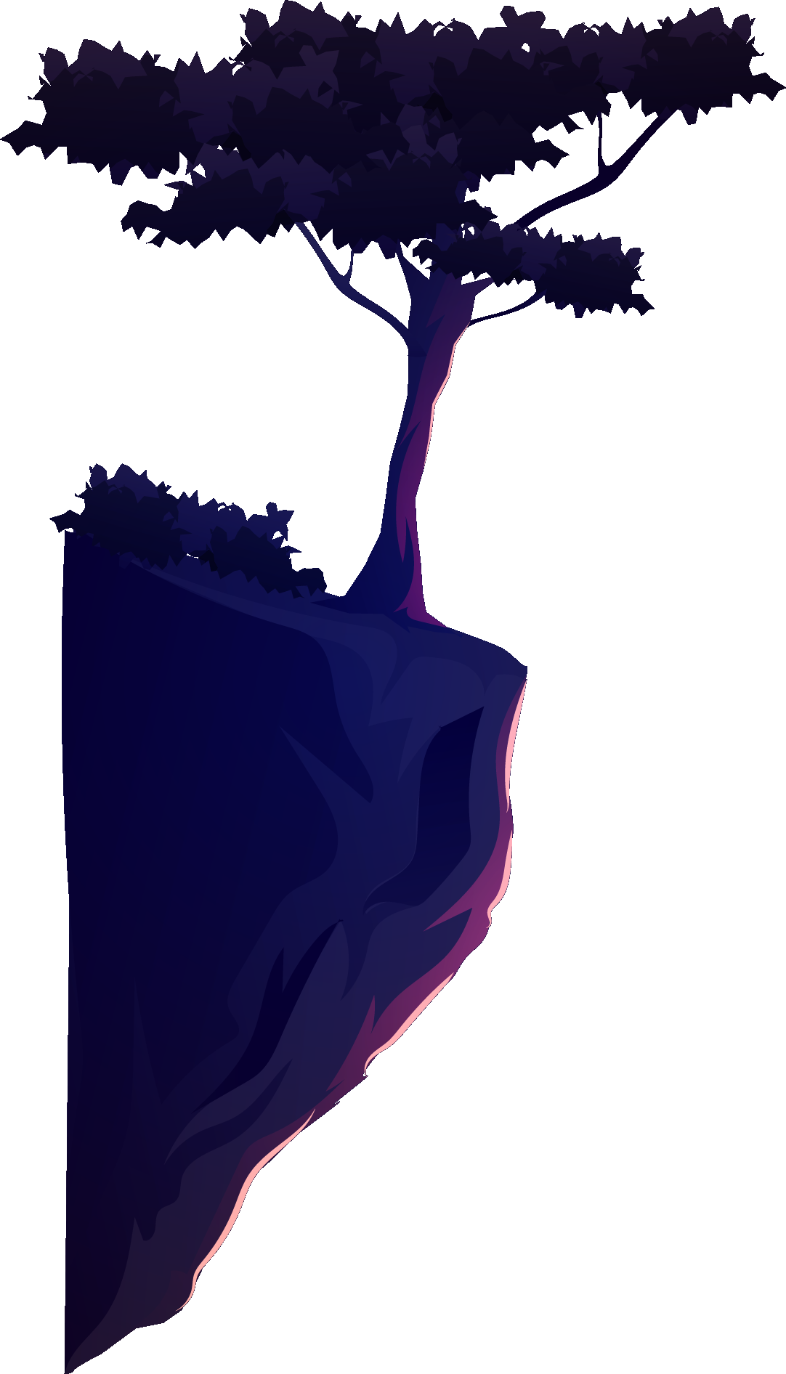
06 - DEMO

Slide 9
07 - Future Work
Model animations
Difficulty Settings
Extra game mode
Multiplayer

Slide 10
Thanks!
Do you have any questions?
goncalo.cunha@ua.pt
https://g0ncalocunha.github.io/wizard_showdown/
Please keep this slide for attribution

